Slide 1

Speak Fluently & Confidently A2- Course 1

Slide 2

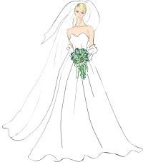
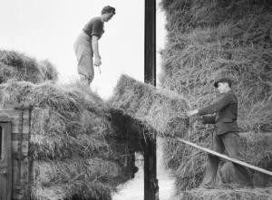
Lesson 16 – Favorite Movie & Book
Warm-Up: Describe your favorite movie and/or book. Why do you like it so much?
Activity 1 – Pre-Learn Vocabulary
bride (n.) = when a woman is getting married, she is called the “bride” on her wedding day. (and the man is called the “groom”)
farmhand (n.) = a person who is employed to work on a farm.

Slide 3
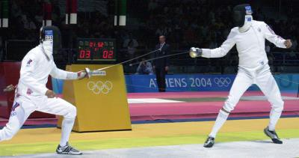
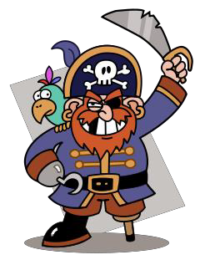
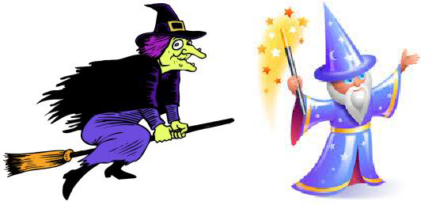
fencing (n.) = a type of sport in which the competitors fight with long, thin swords:
pirate (n.) = a bandit who robs ships on the ocean:
witch (n.) = a woman who does magic, using spells, potions, etc. The male equivalent is a wizard.
villain (n.) = the “bad” character in the story, who is usually the enemy of the hero
satire (n.) = a story that is based on another story (or on real events), but which changes things and uses irony, sarcasm, or ridicule to be humorous or to make a thought-provoking point

Slide 4

Activity 2 – Listen for the General Idea
Speakers: Dan, Ashley - Australian
Dan’s favorite movie can be described as...
a fantasy adventure story
a historical fiction film
a romantic comedy
Ashley's favorite book can be described as...
an action-packed thriller with lots of suspense
a background story for a classic character
an inspirational real-life story

Slide 5
Activity 3 – Listen for Specific Details
True or False?
Dan’s favorite movie came out in 1986.
There is a love story in the movie.
The movie is too violent for children.
The movie is very serious.
Dan memorized the entire movie.
Dan’s favorite part is a chase scene.
The movie inspired Dan to make his own films.
Ashley's favorite book was written in 1995.
The book makes you hate the Wicked Witch even more.
The book was also turned into a movie.

Slide 6
ASHLEY
Hello, my name is Ashley and today I'm going to talk to you about my favorite book. My favorite book is titled Wicked: The Life and Times of the Wicked Witch of the West, and it was written by Gregory Maguire in 1995 and this book Click here to enter text. on the background story of the Wicked Witch of the West. So it focuses on her family life and how she grew up and the Click here to enter text. leading up to her being the Wicked Witch of the West that you see in the Wizard of Oz. So it really focuses on her before the whole Dorothy story came into play.
And the reason why I really like this is because it gives one of those Click here to enter text. villains, it gives you their background story - so rather than, you know, kind of being like "oh she's a villain, I really don't like her," you read this story and you're like "OK, now I Click here to enter text. why she became who she became, and I actually really like this character and I kind of feel Click here to enter text. for her."
This book is also a famous Broadway play titled "Wicked," and I myself have not seen it on Broadway but I'm hoping that Click here to enter text. I can make it out to New York - hopefully it's still playing - so I can see it on Broadway. I really suggest this book if you like kind of those satires or getting background stories from your Click here to enter text. movies and books - so yeah, Wicked: The Life and Times of the Wicked Witch of the West by Gregory Maguire - check it out!

Slide 7
ASHLEY
Hello, my name is Ashley and today I'm going to talk to you about my favorite book. My favorite book is titled Wicked: The Life and Times of the Wicked Witch of the West, and it was written by Gregory Maguire in 1995 and this book focuses on the background story of the Wicked Witch of the West. So it focuses on her family life and how she grew up and the events leading up to her being the Wicked Witch of the West that you see in the Wizard of Oz. So it really focuses on her before the whole Dorothy story came into play.
And the reason why I really like this is because it gives one of those evil villains, it gives you their background story - so rather than, you know, kind of being like "oh she's a villain, I really don't like her," you read this story and you're like "OK, now I understand why she became who she became, and I actually really like this character and I kind of feel bad for her."
This book is also a famous Broadway play titled "Wicked," and I myself have not seen it on Broadway but I'm hoping that someday I can make it out to New York - hopefully it's still playing - so I can see it on Broadway. I really suggest this book if you like kind of those satires or getting background stories from your classic movies and books - so yeah, Wicked: The Life and Times of the Wicked Witch of the West by Gregory Maguire - check it out!

Slide 8
Extra Vocabulary
"This movie came out in 1987"
We often use the phrasal verb “come out” when talking about the date, season, or year that a movie is released to the public.
"Wesley decides to leave to seek his fortune"
This expression means “to try to become rich and successful.”
"To quote a line from the movie"
To “quote” means you are repeating something someone said exactly.
"I don't want to give away too much"
In this context, the phrasal verb “give away” means “reveal secret information.”
Activity 2 Answers:
a
b
Activity 3 Answers:
False
True
False
False
True
False
True
True
False
False

Slide 9
Session 3 – Revision 1
Let’s Review then Learn something New
Revision (1)
Talking about ‘Preferences’ & ‘Family’
https://befluent.me/

Slide 10
Session 3 – Revision 1
Part 1: Grammar
Part 2: What would you say in the following
situations? ( Idioms & collocations)
Part 2: Speaking Practice
https://befluent.me/

Slide 11
Session 1- Likes & Dislikes
Part 1: Grammar
https://befluent.me/

Slide 12
The Present Simple Tense (also called the Simple Present Tense)
1- Simple present tense with verb to 'be':
The verb ‘be’ is different from the other verbs in this tense. Let's look at ‘be’ first:
Here’s the positive form (positive means a normal sentence, not a negative or a question. This is sometimes called ‘affirmative’):
Positive | Positive Short Form
I am | I'm
you are | you're
he is | he's
she is | she's
it is | it's
we are | we're
they are | they're
For example:
I’m Scottish.
She’s hungry.
They’re always late.
Next, here's the negative. It's very easy. You only add ‘not’ after the verb ‘be’:
Negative | Negative short form
I am not | I'm not
you are not | you aren’t
he is not | he isn't
she is not | she isn’t
it is not | it isn't
we are not | we aren't
they are not | they aren't
For example:
I’m not cold.
He isn’t from Spain.
We aren’t at home.

Slide 13
Here's the 'yes / no' question form:
Yes / No Questions
am I ?
are you ?
is he ?
is she ?
is it ?
are we ?
are they ?
For example:
Am I next in the queue?
Are you from Tokyo?
Is he at the library at the moment?
If you'd like to make a ‘wh’ question, you just put the question word at the front
Wh Questions
Where am I ?
What are you ?
Why is he ?
Who is she ?
When are we ?
How are they ?
For example:
Where are you from?
Who is that girl?
Why are they still at work?

Slide 14
Write the correct form of verb to be in the present simple tense:
(she / be / kind?)
(they / be / German?)
(you / be / late?)
(I / be / early?)
(you / be / from London?)
(they / be / sad)

Slide 15
Present simple tense with other verbs:
With all other verbs, we make the present simple in the same way.
The positive is really easy. It's just the verb, with an extra ‘s’ if the subject is ‘he’, ‘she’, or ‘it’. Let's take the verb ‘play’ as an example:
Positive (of 'play')
I play
you play
he plays
she plays
it plays
we play
they play
For example:
I play tennis every week.
He likes chocolate.
They usually go to the cinema on Fridays.
Don't forget the ‘s’! Even really advanced students do this!
For a few verbs, there is a spelling change with ‘he’, ‘she’ and ‘it’ before the ‘s’.
For example, ‘study’ becomes ‘studies’. (will explain this in the next slide).
.
There are also few verbs which are irregular in the present simple:
'have' becomes 'has'
'do' becomes 'does'
'go' becomes 'goes'

Slide 16
Present Simple Spelling Changes
Some verbs have present simple spelling changes with 'he', 'she' or 'it’:’
Verbs that end in 'y’:
Verbs that end in 'y' often change 'y' to 'ie' before 's':
study becomes studies
try becomes tries
marry becomes marries
fly becomes flies
cry becomes cries
(Be careful! 'y' doesn't change to 'ie' if the ending is 'ay', 'ey', 'oy', 'uy'. So, play becomes plays, say becomes says, buy becomes buys, enjoy becomes enjoys, stay becomes stays)
Verbs that end in 's', 'sh', 'ch', or 'x’:
Verbs that end in 's', 'sh', 'ch' or 'x' often add 'e' before 's':
pass becomes passes
wash becomes washes
teach becomes teaches

Slide 17
Make positive present simple sentences:
(Adam / go to school every day)
(I / like swimming)
(you / play badminton on Saturdays)
(the class / begin at 9 a.m.)
they / sometimes go to the cinema)
. (Maria / love chocolate)
(we / study French)
(the Simpson’s / live in London)
Put the verb into the present simple. Be sure you spell it correctly!
She __________________ (play) tennis every Sunday.
2. He __________________ (buy) a cup of coffee every morning.
3. Julie __________________ (study) French at school.
4. Luke __________________ (try) hard to be polite.
5. She __________________ (enjoy) going swimming.
6. Lucy __________________ (wash) her hair every day.
7. John never __________________ (cry).
8. My mother always __________________ (say) that love is more important than money.

Slide 18
To make the negative form, you need to use ‘do not’ (don't) or ‘ does not’ (doesn't):
Negative (of 'play') | Negative Short Form
I do not play | I don't play
you do not play | you don't play
he does not play | he doesn't play
she does not play | she doesn't play
it does not play | it doesn't play
we do not play | we don't play
they do not play | they don't play
For example:
You don’t study very much.
Julie doesn’t like sport.
We don’t live in London.

Slide 19
Make negative present simple sentences:
(I / not / live in Paris) __________________________________________________________________
(she / not / come from Spain) __________________________________________________________________
. (John / not / work in a bank)
(they / not / get up at eight o’clock) __________________________________________________________________
(we / not / go to the cinema every Friday)
(you / not / read the newspaper every day) _________________________________________

Slide 20
How about the question form of the present simple tense?
(1) We use 'do' or 'does' before the subject to make the 'yes / no' question:
Yes / No questions
do I play ?
do you play ?
does he play ?
does she play ?
does it play ?
do we play ?
do they play ?
(2) Just like with 'be', if you'd like to make a 'wh' question, you just put the question word at the front:
Wh Questions
where do I play ?
what do you play ?
why does he play ?
who does she play ?
when do we play ?
how do they play ?

Slide 21
Make the present simple question:
(he / drive to work every day?)
(we / have enough time?) ________________________________________________
( what / you / eat in the morning?)
(they / write e-mails every day?) ____________________________________________________
when/ he / / read the newspaper?)
where / I / come on Mondays?)
(what / you / do at the weekend?)

Slide 22
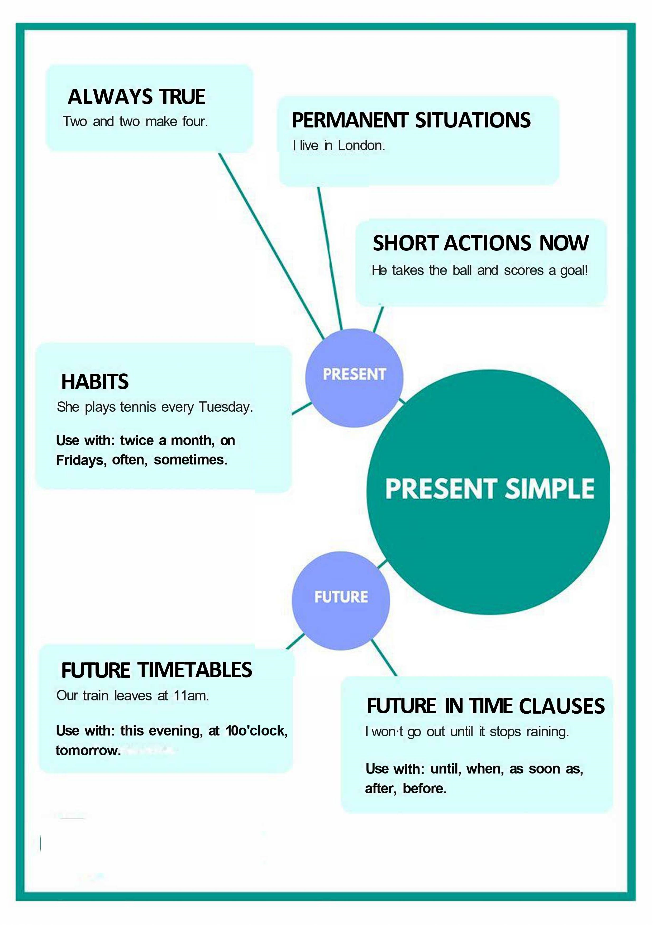
Session 1- Likes & Dislikes
https://befluent.me/

Slide 23
Session 1- Likes & Dislikes
When to use the Present simple tense- Function:
1: We use the present simple when something is generally or always true.
People need food.
It snows in winter here.
Two and two make four.
2: Similarly, we need to use this tense for a situation that we think is more or less permanent.
Where do you live?
She works in a bank.
I don't like mushrooms.
3: The next use is for habits or things that we do regularly. We often use adverbs of frequency (such as 'often', 'always' and 'sometimes') in this case, as well as expressions like 'every Sunday' or 'twice a month’.
Do you smoke?
I play tennis every Tuesday.
I don't travel very often.
https://befluent.me/

Slide 24
Session 1- Likes & Dislikes
When to use the Present simple tense- Function:
4: We can also use the present simple for short actions that are happening now. The actions are so short that they are finished almost as soon as you've said the sentence. This is often used with sports commentary.He takes the ball, he runs down the wing, and he scores!
Future Uses
5: We use the present simple to talk about the future when we are discussing a timetable or a fixed plan. Usually, the timetable is fixed by an organization, not by us.
School begins at nine tomorrow.
What time does the film start?
The plane doesn't arrive at seven. It arrives at seven thirty.
https://befluent.me/

Slide 25
Session 1- Likes & Dislikes
When to use the Present simple tense- Function:
6: We also use the present simple to talk about the future after words like ' 'when', 'until', 'after', 'before' and 'as soon as'. These are sometimes called subordinate clauses of time.
I will call you when I have time. (Not 'will have'.)
I won't go out until it stops raining.
I'm going to make dinner after I watch the news.
Conditional Uses 7: We use the present simple in the first and the zero conditionals.
If it rains, we won't come.
If you heat water to 100 degrees, it boils.
https://befluent.me/

Slide 26
Make the present simple, positive, negative or question:
I _________________ (be) in a café now.
2. _________________ (she / play) tennis every week?
3. They _________________ (go) to the cinema every Wednesday.
4. _________________ (she / be) a singer?
5. You _________________ (find) the weather here cold.
6. _________________ (they / be) on the bus?
7. Lucy _________________ (ride) her bicycle to work.
8. Why _________________ (he / be) in France?
9. I _________________ (not / play) the piano often.
10. It _________________ (not / be) cold today.
Where _________________ (Harry / study?

Slide 27
Session 3 – Revision 1
Part 2-: What would you say in the following
situations? ( Idioms & collocations)
https://befluent.me/

Slide 28
Remember:

Slide 29
Lesson 1: Likes, Dislikes, & Preferences
Vocabulary Quiz
especially • with you • either • mind • takes forever
I don’t spending some time outside .
I agree. I’m on that point.
I like swimming, but it to get to the pool.
I love sports, basketball.
I do not eat meat, and my wife does not eat it .

Slide 30

Remember:
Phrases for liking something:
“I like...”
I like… Italian food / rock music / learning languages.
Your sentence: I like
“I like it a lot.” / “I really like…” (more common)
I like… this restaurant / my teacher …a lot.
I really like… my new apartment / playing tennis / my boyfriend’s parents.
Your sentence: I really like
“I love…”
I love your haircut! / I love to read. / I love the way he writes.
Your sentence: I love _
“I absolutely love…”
I absolutely love this dress. / I absolutely love traveling with my family.
Your sentence: I absolutely love

Slide 31
Remember:
These are the most common expressions. “I like” is the weakest, and “I absolutely
love…” is the strongest.
You can use “like” and “love” for both nouns (like food, houses/apartments, music, movies, books, etc.) and verbs (reading, learning, playing tennis, etc.)
As mentioned in a previous lesson, after “like” and “love” you can use either the “to” form or the –ing form of the verb with no difference in meaning. I like to read = I like reading.
Note:
Be careful not to make the common mistake of saying “I like very much this city” – the correct way to say it is: “I like this city very much.”

Slide 32

Here are a few phrases for liking things that are used in more specific situations:
“I'm fond of...”
This phrase is used when you have a special, warm, emotional attachment to
something. For example, you could say, “I’m fond of this photo. It was taken on
our honeymoon.” The expression “I’m fond of…” can also be used for people.
Your sentence: I’m fond of
“I'm crazy about...” / “I’m really into…”
Both of these phrases are informal.
Your sentence: I’m crazy about
“I didn’t like it at first, but then it grew on me.”
Use this phrase when you didn’t like something initially, but then you began to
like it as time passed.
Your sentence: I didn’t like at first, but then it grew on me.
Remember:

Slide 33
Phrases for disliking something:
We don't usually say "I dislike" in English. It's more typical to say "I don't like..." However, depending on the situation, you might want to express your dislike more indirectly. These phrases are diplomatic and polite ways to say you don’t like something:
“I'm not a big fan of...”
I’m not a big fan of horror movies.
Your sentence: I’m not a big fan of _ .
“I'm not crazy about...”
I’m not crazy about this painting.
Your sentence: I’m not crazy about .
Remember:

Slide 34
Phrases for disliking something:
I don’t really like going to parties where I don’t know anybody. I don’t really like my sister-in-law.
I don’t really like video games.
Your sentence: I don’t really like _ .
“It's not my thing. / It's not my cup of tea.”
Skiing is not my thing.
Going to nightclubs is not my cup of tea.
These expressions are used only for activities, not for people or objects.
Your sentence: _ _ is not my thing.
The first three phrases are most typically used with objects. The last phrases are used for activities.
And the phrase “I don’t really like…” can be used for people, objects, or activities.
Remember:

Slide 35
If you want to express strong dislike, you can use these phrases:
“I can't stand...”
I can’t stand Margaret. She talks too much!
I can’t stand it when people call me and don’t leave a message.
Your sentence: I can’t stand .
“I don't like it at all.”
I don’t like this hotel at all.
I don’t like Peter at all. He seems dishonest.
Your sentence: I don’t like _ at all.
“I hate...”
I hate tomatoes.
I hate going out in the rain. Your sentence: I hate _ .

Slide 36
The expression “I can’t stand…” is used more for annoying things. “I don’t like it at all” is a strong statement of dislike, and “I hate…” is the strongest statement.
A few other words for “hate” are loathe, detest, and despise, although these are less common.
One very common structure is to say “I hate it when…” or “I can’t stand it when…” and then describe the situation that angers or annoys you.
“I hate to delay the project any further.” This way of using the word “hate” means something more like “I don’t want to delay the project any further” or “I think it’s unfortunate to delay the project any further.”

Slide 37
Remember:
Finally, what do you say if you have no preference? Here are a few options:
Which one do you prefer? Which one do you like better?
“It doesn’t matter to me.”
“It makes no difference to me.”
“It’s all the same to me.”
“I don’t care. / I couldn’t care less.”
These phrases – especially the second one – are a little bit rude.
“It's up to you. / It's your decision. / It's your call.”
Say these when you don’t have a preference, and you want the other person to make the decision.

Slide 38
Vocabulary Quiz
looking out for • obviously • chores • gene • fit • strangers
He exercises every day. He is very .
My mom is always out for me.
He is not happy. He looks sad.
You can meet when you travel.
He has the humor in the family.
Just like many women, I do not like doing the .

Slide 39
Session 2- Talking about Family
Like Father, Like Son
Meaning: Sons inherit their fathers’ traits and preferences, often even without realizing it.
Example: John was a great fisherman. His son Matt is aalso a great fisherman. Like father, like son.
Run in the Family
Meaning: Be inherited (as a trait) by multiple members of a family
Example: I’m not surprised Maria has started playing in a band. Musical talent runs in her family.
One Big Happy Family
Meaning: A group of people who live or work together and are very close
Family Man
Meaning: A man devoted to taking care of his wife and children
A Helicopter Parent
Meaning: a parent who overprotects and overcontrols their children, hovering around like a helicopter and monitoring everything that the children.
Example: His mum was a real helicopter parent and sent instructions to the kitchen on how to cook her son’s rice for every meal.
https://befluent.me/

Slide 40
Session 3 – Revision 1
Part 3: Speaking Practice
https://befluent.me/

Slide 41
Session 3 – Revision 1
What are your favorite kinds of programs or shows?
Who are your favorite actors?
Do you like programs or shows from other countries as well? If so, what kind?
Do you like actors from other countries as well? If so, who?
What kinds of programs or which actors don't you like?
Do you like movies?
What are your favorite kinds of movies?
What are your all time favorite movies?
Who are your favorite actors?
Do you like movies from other countries as well? If so, what kind?
Do you like actors from other countries as well? If so, who?
What kinds of movies or which actors don't you like?
https://befluent.me/

Slide 42
Do you like sports?
Student :
Correction:
What are your favorite kinds of sports?
Who are your favorite athletes?
Do you like sports from other countries as well? If so, what kind?
Do you like athletes from other countries as well? If so, who?
Which athletes don't you like?
Do you like reading?
Do you like books?
Do you like reading books offline or online?
What are your favorite kinds of books?
What are your favorite book titles?
Who are your favorite authors?
Session 3 – Revision 1
https://befluent.me/

Slide 43
Do you like sports?
Student :
Correction:
What are your favorite kinds of sports?
Who are your favorite athletes?
Do you like sports from other countries as well? If so, what kind?
Do you like athletes from other countries as well? If so, who?
Which athletes don't you like?
Do you like reading?
Do you like books?
Do you like reading books offline or online?
What are your favorite kinds of books?
What are your favorite book titles?
Who are your favorite authors?
Session 3 – Revision 1
https://befluent.me/

Slide 44
Session 3 – Revision 1
What is your favorite color?
What is your least favorite color?
Do you like house work?
What is your favorite chore?
What is your least favorite chore?
Name a chore that you loathe.
Do you like pets? Do you have one?
What is your favorite pet?
Do you like wearing make-up?
Do you read beauty magazines? ?
What’s your opinion of beauty pageants like Miss Universe?
How have our ideas about beauty changed generally? What does this tell us?
“No Make-Up Day”: would this be a good idea?
https://befluent.me/

Slide 45
Session 1- Likes & Dislikes
Do you like sports?
What are your favorite kinds of sports?
Who are your favorite athletes?
Do you like sports from other countries as well? If so, what kind?
Do you like athletes from other countries as well? If so, who?
Which athletes don't you like?
Do you like reading?
Do you like books?
Do you like reading books offline or online?
What are your favorite kinds of books?
What are your favorite book titles?
Who are your favorite authors?
https://befluent.me/

Slide 46
Session 2- Talking about Family
(Like Father, Like Son -Run in the Family- One Big Happy Family -Family Man- A Helicopter Parent)
Answer the following questions using some of the above idioms:
What do you like doing when you spend time with your family?
Student :
Correction:
Did you ever meet any of your great grandparents?
Student :
Correction:
How did you get your name? Who are you named after?
Student :
Correction:
What is the most important thing your parents taught you?
Student :
Correction:
https://befluent.me/

Slide 47
Session 2- Talking about Family
(Like Father, Like Son -Run in the Family- One Big Happy Family -Family Man- A Helicopter Parent)
Answer the following questions using some of the above idioms:
If you could have a different number of siblings and children, what would it be? Why?
Student :
Correction:
If you were offered an excellent job opportunity abroad, would you consider leaving your family for an indefinite period of time?
Student :
Correction:
https://befluent.me/

Slide 48
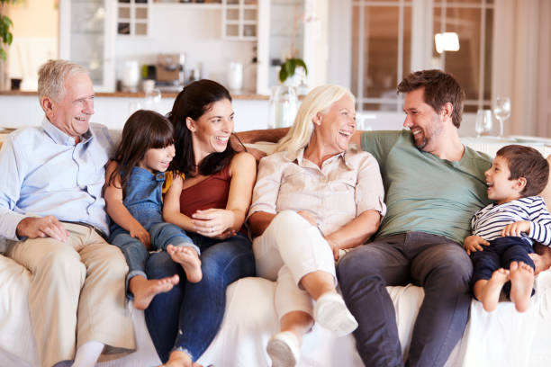
Session 2- Talking about Family
(Like Father, Like Son -Run in the Family- One Big Happy Family -Family Man- A Helicopter Parent)
There is much talk recently of increased social problems due to family breakdown. Is this true?
Student :
Correction:
Do you ever get tired of family duties?
Student :
Correction:
Do you consider close friends as family? Explain why?
Student :
Correction:
Describe this picture.
https://befluent.me/

Slide 49
Session 3 – Revision 1
Thank you!☺
https://befluent.me/

